Slide 1
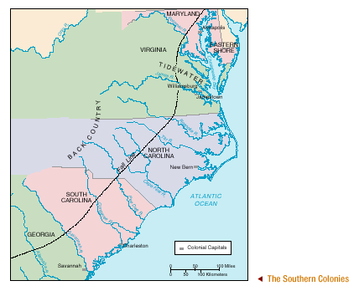
The Southern Colonies

Slide 3
Types of Colonial Charters
Company – colonial charter given to a company or group of settlers (i.e. Virginia)
Royal – colonies directly controlled by the crown (i.e. New York)
Proprietary – colonial charter given to one or more individuals (proprietors) (i.e. Pennsylvania)

Slide 4
Economy of the Southern Colonies
Agriculture
Tobacco, Rice, Indigo ~ cash crops
Plantations – large farms usually specializing in one crop, mostly worked by slaves or indentured servants
Indentured Servants – agree to work on a plantation for a fixed number of years to earn passage to America, freedom and land
Slaves – more than 20,000 in Southern Colonies by 1700

Slide 5
Virginia
Jamestown founded in 1607 by Virginia Company
Huge original area cut down by land grants to Massachusetts, Maryland, and the Carolinas

Slide 6
Maryland
1632 – Lord Baltimore received land grant to found a colony as a refuge for English Roman Catholics
First settlers in 1634
As more protestants moved to area, tensions grew leading to the
Toleration Act of 1649 – mandating religious toleration of all Christian denominations

Slide 7
Maryland Toleration Act
Toleration Act of 1649 – mandating religious toleration of all Christian denominations
Outlawed restricting rights of Christian groups
First law of its kind and
Precursor to the First Amendment

Slide 8
Carolinas
1663 ~ Land given to 8 Lords by Charles II
1670 ~ Charles Town (Charleston) founded
commercial, social and political center of South Carolina
African laborers taught colonists to raise rice in the 1690s
Split into North and South Carolina in 1712
spread out settlements made it hard to govern
North Carolina – very rural and unpopulated until after 1700
mostly made up of farmers from Virginia
South Carolina – Big plantations and proximity to Charleston made for big money
The only colony where slaves outnumbered the white population

Slide 9
Georgia
James Oglethorpe and other trustees given a grant by George II to start a colony for poor, jailed debtors from England
Land formerly part of South Carolina
Hoped to form a border between Spanish Florida and other English Colonies
Founded city of Savannah in 1733

Slide 10
Georgia
Oglethorpe wanted to avoid the rise of plantations to assure small farm success
Prohibited slavery
Limited land grants
Free passage to Georgia, and cattle, land and food until they could provide for themselves
Once successful, colonists wanted to expand
1752 ~ trustees gave up charter
Becomes a Royal Colony
Results in large rice plantations worked by thousands of slaves

