Slide 1
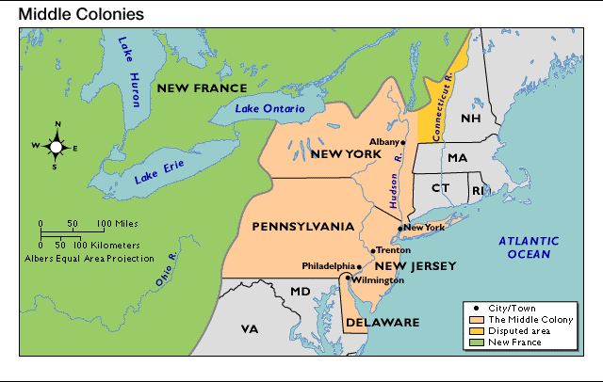
The Middle Colonies
Originally Dutch ~ Henry Hudson, 1609

Slide 2
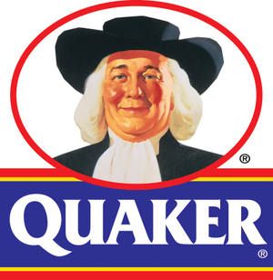
Economy of the Middle Colonies
Combined the qualities of the New England and Southern colonial economies
Most economically dynamic region by 1750
Fur trade was the foundation of the economy in the early years
Farming became increasingly important
Staple crops: wheat, rye, barley, oats, corn
Middle colonies known as “Breadbasket”
Raised and sold livestock
Slaves worked as skilled laborers, on farms and in the shipbuilding industry
Labor needs largely met by indentured servants
1700-1755 ~ 135,000 indentured servants come to Middle Colonies from England and Germany

Slide 3
New York
Originally New Netherlands
1613 ~ founded by Dutch West India Company
1626 ~ Dutch settlers purchase Manhattan for $24 from Man-a-hat-a Native Americans
1664 ~ English fleet takes New Netherlands without a shot ~ New Amsterdam renamed New York
Strong Dutch influence remained after 1664
Religious tolerance of the Dutch attracted many settlers
Jews, French Huguenots, Puritans and others
By 1646 the population along the Hudson River included Dutch, French, Danes, Norwegians, Swedes, English, Scots, Irish, Germans, Poles, Bohemians, Portuguese and Italians -- the forerunners of millions to come.

Slide 4
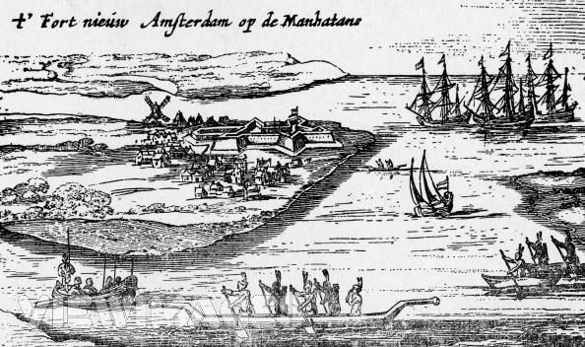
Early View of Colonial New York-1626
Photo by the New York Historical Society

Slide 5
New Jersey
Created from New York after English conquest
Land between the Hudson and Delaware Rivers granted to Sir George Carteret and John Lord Berkeley as proprietors by the Duke of York
Diverse population including Dutch, Swedes, Finns, and Scots

Slide 6
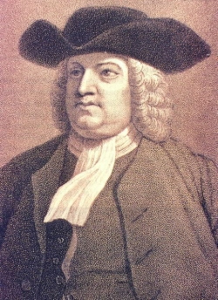
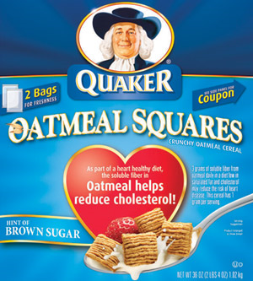
Pennsylvania
Pennsylvania Experiment
A Government fair to all people
1681 ~ English charter given to
William Penn for Quakers
Plain, nonviolent, tolerant religious group
Persecuted in England and American colonies
Penn’s promises attract thousands of settlers
Religious freedom and civil liberties
Model of fair, representative self-government
Fair treatment of Indians and the poor

Slide 7
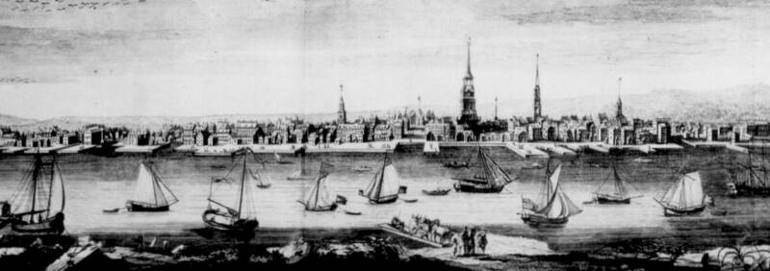
Colonial Port of Philadelphia
City of Brotherly Love was founded in 1682 by William Penn as the capital of his colony.

Slide 8
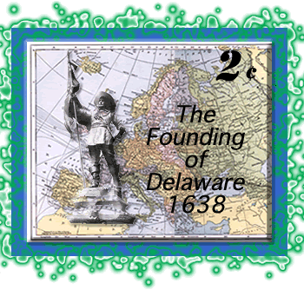
Delaware
Originally New Sweden
1638 ~ Fort Christina
1655 ~ conquered by Peter Stuyvesant and the Dutch
1664 ~ taken by the English
1682 ~ Chartered (sold) to William Penn by the Duke of York
Remained a part of Pennsylvania until 1776

